Slide 1
Importance of Cybersecurity for LMR Systems
April 18, 2024
Notes:
15:36

Slide 2
Introductions
Speaker: MCP’s Nick Falgiatore, Wireless Manager
Nick is the Wireless Manager for Mission Critical Partners, leading a team of 15 engineers and consultants. As a public safety wireless specialist, Nick has served more than 100 public safety clients ranging in size from small municipalities to state agencies. His experience encompasses all aspects associated with the implementation of public safety communications systems, including needs assessments, system procurements and implementation engineering support. He is also a subject matter expert with regard to FCC regulations and coverage modeling. Nick holds a master’s degree in Electrical Engineering and is also a licensed Professional Engineer.

Slide 3
Who We Are
The leader in providing professional and managed services for the public sector - primarily public safety and justice.

Slide 4
Executive Summary: What we do?
What We Do
We provide confidence and support, ranging from strategy, assessment, procurement, implementation, and managed services, for a wide range of mission-critical and public-sector clients. Our primary lines of services:
Cybersecurity
IT Managed Services
Network & Application Monitoring
Strategy & Management
Next Generation 911
Facilities & Operations
Wireless Communications
Technology Acquisition & Implementation
Data Integration
Software Implementation
Application Modernization

Slide 5
Our Unique Value Proposition
We provide clients the right technology for maximum value; we bring objective guidance.
Our offering enables us to go broad and deep with our clients.
Minimize financial, schedule, and operational risks, including risks from outages and cyberattacks.
Intimate knowledge of the public safety and courts sectors.
Improve contracted outcomes for our clients and their communities.

Slide 6
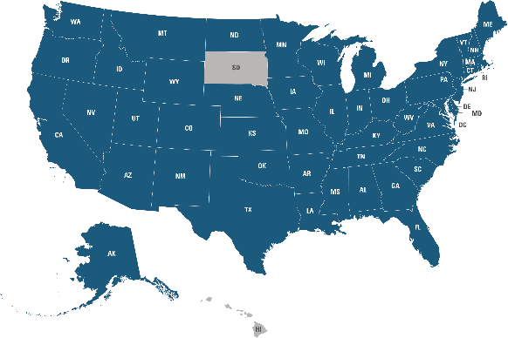
MCP has a 14-Year Tradition of Improving Emergency Response and Justice Outcomes
Founded in 2009 in State College, PA
Vendor agnostic firm with 230+ specialized experts who provide Professional and Managed Services
Serving clients in 48 states
Helping to enhance mission critical services in 95% of the nation’s largest metropolitan areas
SIX acquisitions in FOUR years
2018
2020
2021
2022

Slide 7
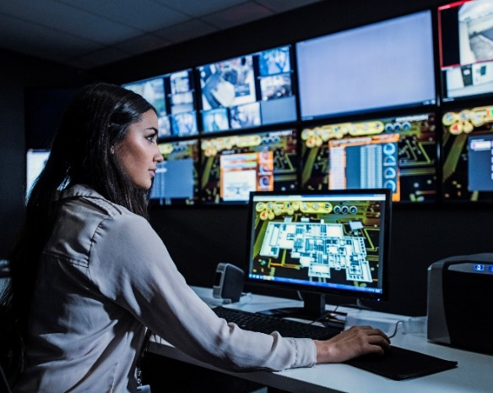
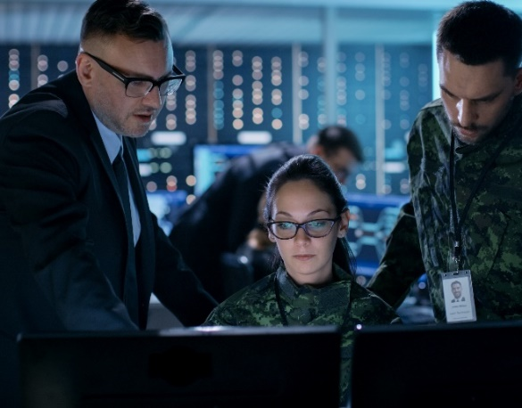
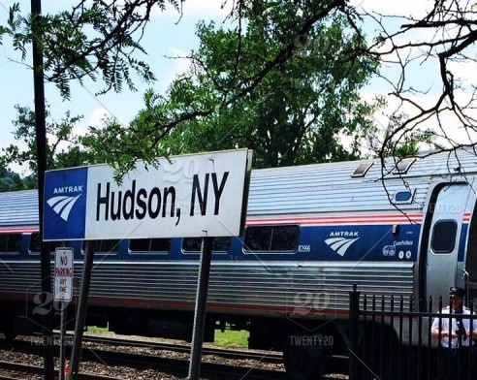
Markets We Serve
911 / Public Safety
First Responders
Federal / Military
Utilities
Justice
Transportation
Private Sector
Healthcare

Slide 8
Agenda
The Cybersecurity Threat
Why Are Radio Networks Good Targets?
What Has Changed with Radio System Architecture?
Conventional Networks
Trunked Networks
System Vulnerabilities
Case Study
Mitigation Strategies

Slide 9
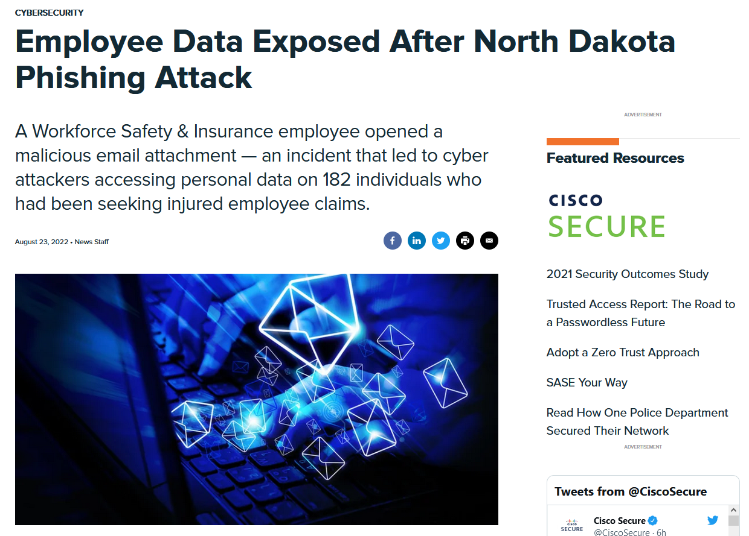
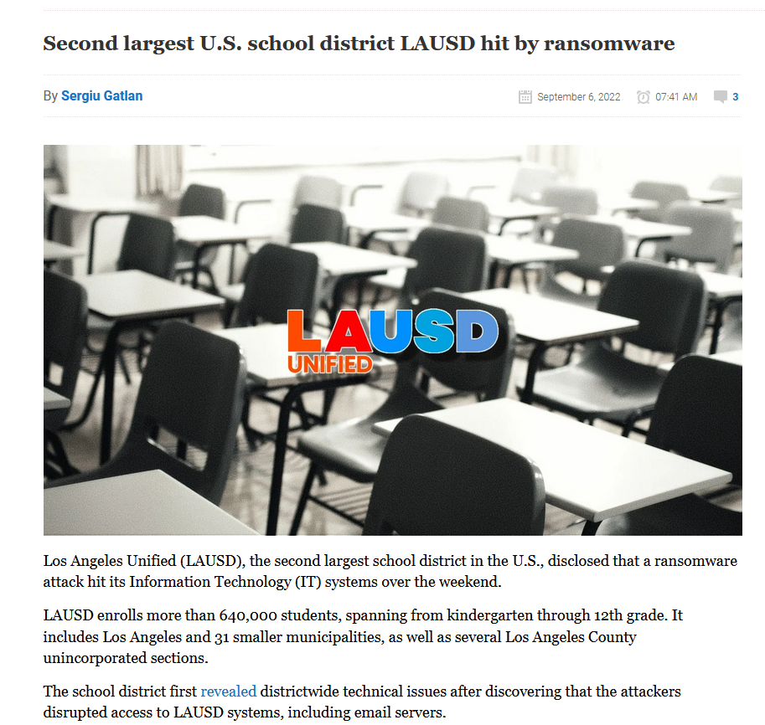
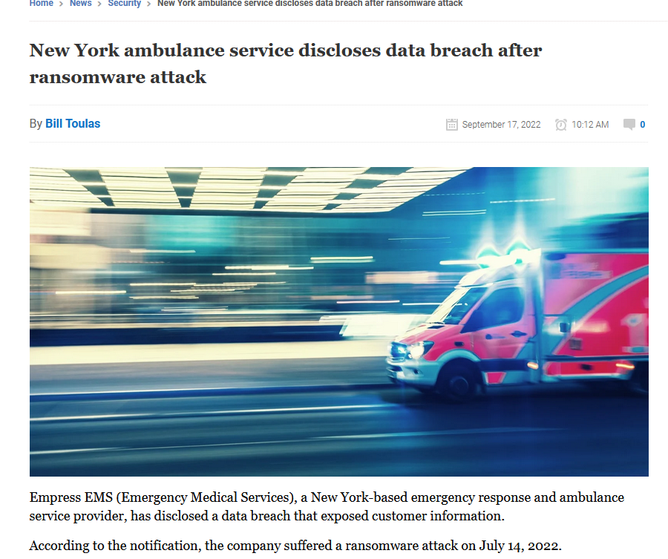
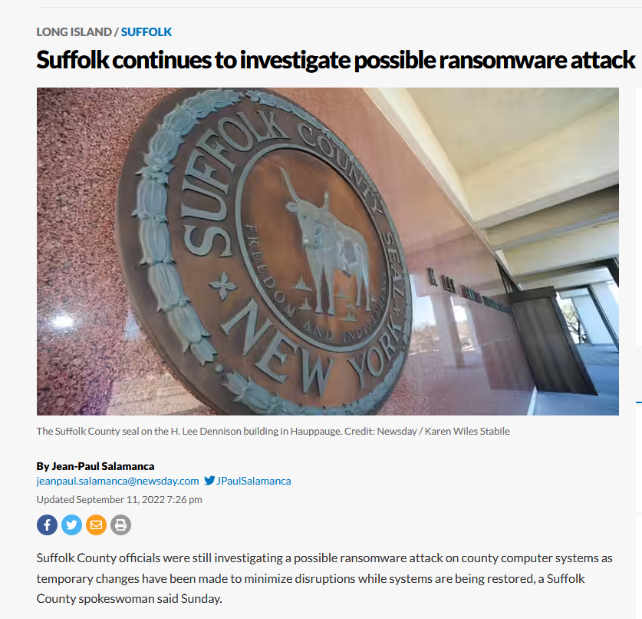
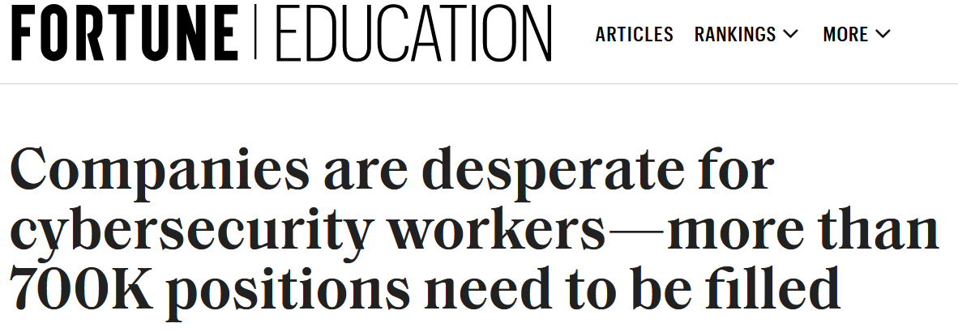
An Ever-Growing Problem
According to CISA:
47% of PSAPs indicated they have suffered a cybersecurity incident
35% indicated they don’t have funding for cyber maintenance costs
63% do not have incident response plans
65% do not have a mitigation strategy in place
All amidst a tight labor market and severe shortage of cyber engineers
Notes:
New York ambulance service Empress EMS – Hive Ransomware Gang attack; on network for 12 days before launching
Suffolk County NY – Ransomware Attack on County web-facing systems, Extortion tactics used, posting residents’ data stolen
LA School District – Ransomware Attack, email borne attack affected 640K students
Chester-Upland ISD, PA – Email server hacked which allowed impersonation emails to divert funds; all but $3M recovered

Slide 10
The Facts
Ransomware attacks are the most common cybersecurity threat.
Government networks are prioritized targets:
Networks supporting critical functions that can’t go down
Funds available to pay high ransoms
Many individuals with access
Radio systems are IP networks that can fall victim to cyberattacks just like any other government network.

Slide 11
Why Are Radio Networks Good Targets?
Critical operation (acceptable annual outages measured in seconds)
Much publicly available information available online
Networks housing sensitive information
Use of standards-based IP networks
All equipment components that leverage off-the-shelf operating systems with known exploits

Slide 12
What Has Changed with Radio System Architecture?
The Good Old Days | Now
Completely isolated networks | Many external connections
Dedicated backhaul networks | Shared backhaul networks
Circuit-switched backhaul | IP backhaul
Few individuals with administrative access | Many individuals with administrative access
Local system access only | Remote system access
Few cybersecurity threats | Many cybersecurity threats
100% on-premises equipment | Cloud-hosted services

Slide 13
Potential Impacts to Radio Systems
Radio System Impact | Severity
Redundant component disabled | Minor
Radio site offline | Moderate
Unauthorized access to system | Moderate
Short-term system-wide outage | Severe
Long-term system-wide outage | Catastrophic

Slide 14
Conventional Networks
The most common radio system technology, used primarily by smaller agencies and some major cities
Limited system security features available
Frequency information available online
PL/NAC codes available online
Ability of bad actors, with relatively low cost and expertise, to talk on these networks
Tracking down of rogue radios extremely difficult
Systems with IP backhaul generally on shared networks

Slide 15
Trunked Networks
Greater protection from invalid users
Unit IDs
Radio inhibit
Ability to disable frequencies when interference present
Standardized security policies from manufacturer
External internet connection through firewalls
Use generally in more populated areas and thus bigger targets

Slide 16
Types of Cyberattacks Against LMR Systems
RF interference/jamming Interception/eavesdropping Duplicate radio IDs Poor cyber hygiene Unauthorized network access Unauthorized data access | Insider threat Malicious applications Malware Ransomware Spear phishing Supply Chain Hacks | Hardware trojan Failure of synchronization Disruption of trunked operations Spoofing Denial-of-service attack

Slide 17
P25 Network Vulnerabilities 1 – Copper Theft
Severity | Moderate
Impact | Disabling of an individual radio site, reduced coverage
Remediation Activities | Replace impacted conductors (grounding, coax)
Restoration Time | 1 to 2 weeks
Prevention | Radio Site Physical Security 8’+ fence height Barbed wire Cut-resistant locks Unique lock combinations Limit exposed copper Access control systems Surveillance cameras

Slide 18
P25 Network Vulnerabilities
2 – RF Jamming
Severity | Moderate/Severe
Impact | Disabling of an individual radio site or multiple sites
Remediation Activities | Use specialized test equipment to locate interfering source
Restoration Time | 2 to 3 days
Prevention | Have interference-locating resources and expertise readily available Monitor system for high quantity of illegal carriers Baseline site noise floor measurements

Slide 19
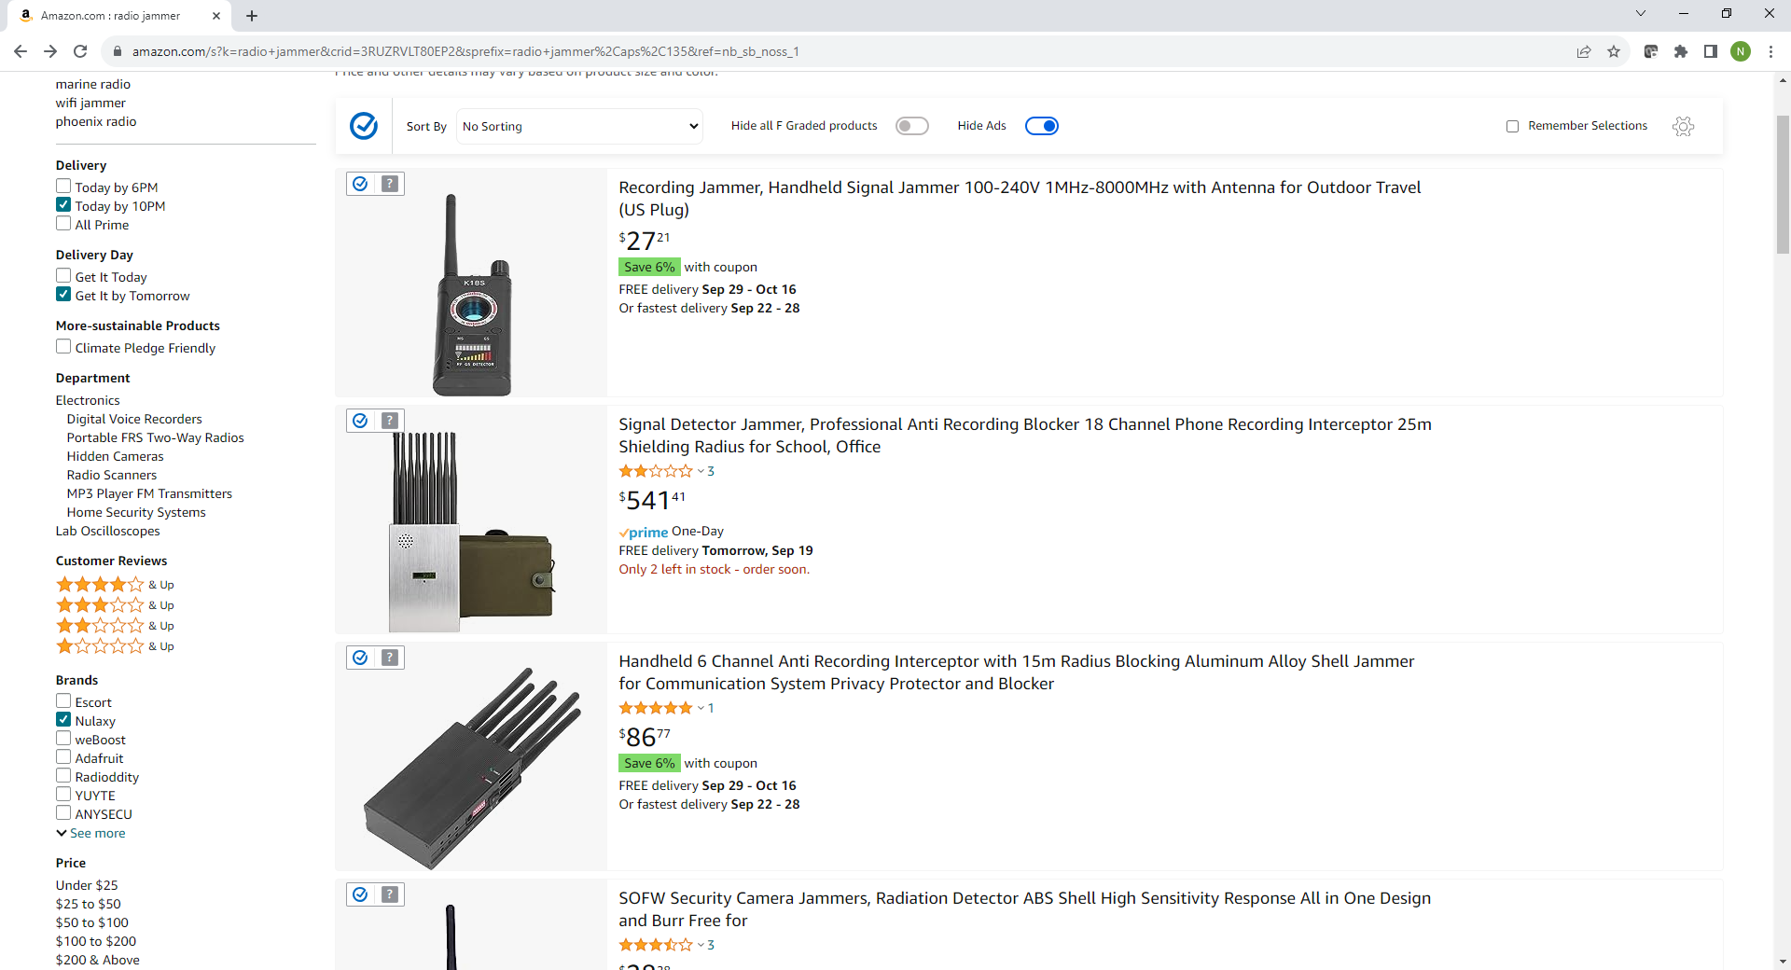

Slide 20
P25 Network Vulnerabilities 3 – Unauthorized System Access
Severity | Minor/Moderate/Severe
Impact | Overloading/spamming of a channel/talkgroup
Remediation Activities | Identify guilty radio ID and inhibit radio (if available) Locate problematic radio using specialized equipment (extremely difficult) Change PL/NAC code on fixed and mobile equipment
Restoration Time | Less than 1 hour (if radio inhibit available) Weeks to months (if radio inhibit not available)
Prevention | Use technology with radio inhibit available (digital trunking, MDC1200, etc.) Follow radio physical security policies Implement SOP should a situation arise

Slide 21
P25 Network Vulnerabilities 4 – Cybersecurity Threat from Within Network
Severity | Severe/Catastrophic
Impact | Potentially disabling of network
Remediation Activities | Restore configurations from on-site backup
Restoration Time | 3 days to 3 weeks
Prevention | System access control 2-factor authentication Disabling of unused USB ports Disabling of unused Ethernet ports Disabling of mass storage devices Physical security for all system locations and equipment Authorized users list User-specific login credentials Non-predictable passwords Security updates Etc.

Slide 22
P25 Network Vulnerabilities 5 – Cybersecurity Threat on Backhaul Network
Severity | Severe/Catastrophic
Impact | Potentially disabling of network
Remediation Activities | Restore configurations from on-site backup
Restoration Time | 3 days to 3 weeks
Prevention | System access control 2-factor authentication Disabling of unused USB ports Disabling of unused Ethernet ports Disabling of mass storage devices Physical security for all system locations and equipment Authorized users list User-specific login credentials Non-predictable passwords Security Updates Etc.

Slide 23
P25 Security Features
Encryption – Secure radio traffic by scrambling the bits so that radio traffic cannot be monitored over-the-air by a scanner
Coordination of encryption keys can be very difficult with interoperability environments
Link layer authentication – Prevents cloning of radio IDs
Almost impossible to enforce when there are a large number of interoperability partners with IDs on your system
Link layer encryption – Encrypts the radio ID and talkgroup ID of over-the-air messages in addition to the audio traffic
These features address very specific vulnerability and do not mean your system is secure

Slide 24
Case Study – Cybersecurity Assessment
Recent cybersecurity assessment on P25 system in large urban area
Key findings:
Open Ethernet ports with network access
Ability to copy files to network from connected devices
Ability to connect mass storage devices on USB ports
Common login credentials used for system access by vendor
Predictable passwords
Ability to traverse network between sites
Ability to penetrate network, scan devices, and change configurations without detection (system had security monitoring in place)

Slide 26
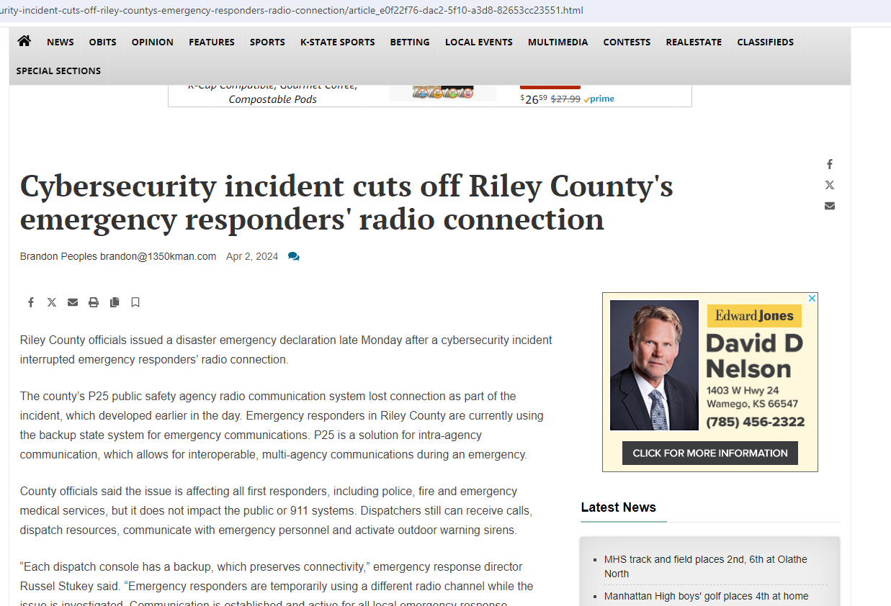

Slide 27
Key Steps for Mitigation
Identify
Protect
Detect
Recover
Respond
1
2
3
4
5

Slide 28
Parting Thoughts
Land Mobile Radio networks are susceptible to cyberattacks like any other network.
The most common tactics for the intentional disruption of service are RF jamming, eavesdropping, and unauthorized access; conventional networks are especially vulnerable.
Radio networks are more susceptible to cyber attacks today than in the past
A cyberattack can be particularly catastrophic, resulting in a prolonged system-wide outage.
Taking proper steps to understand your risks, mitigate them, and prepare for an attack is essential.
Have a cybersecurity assessment performed on your radio system by an independent third party.

Slide 29
Resources
https://www.cisa.gov/sites/default/files/2023-02/22_0906_safecom_cyber_risks_to_lmr_first_edition_v2_508C%20%281%29.pdf
https://resources.missioncriticalpartners.com/news/among-land-mobile-radio-system-users-cybersecurity-must-be-a-top-priority

Slide 30
What about the security of your radio system keeps you up at night?

Slide 31
Contact Info
Nick Falgiatore, PE, ENP, MSEE
Senior Technology Specialist
NickFalgiatore@MissionCriticalPartners.com
MissionCriticalPartners.com
Nick Falgiatore

