Slide 1
State 9-1-1 Reimbursement Guidelines
Carrie Johnson
Reimbursement Claims
Carrie.Johnson@caloes.ca.gov

Slide 2
Presentation Overview
Guidelines/Policies of Annual Training Allotment (ATA)
What is Annual Training Allotment (ATA) reimbursement
State approved reimbursement expenses
Putting together a reimbursement packet
Forms required for reimbursement

Slide 3
Annual Training Allotment (ATA)
Each PSAP and the 9-1-1 County Coordinators may be reimbursed based on call volume per state fiscal year (July 1 through June 30) for specifically defined 9-1-1 related training that is held within the State of California within that fiscal year . The unspent ATA balance cannot be applied to the next fiscal year.
After ATA balance is exceeded all subsequent claims will NOT be reimbursed.

Slide 4
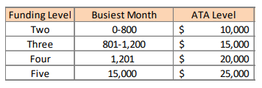
Annual Training Allotment (ATA)

Slide 5
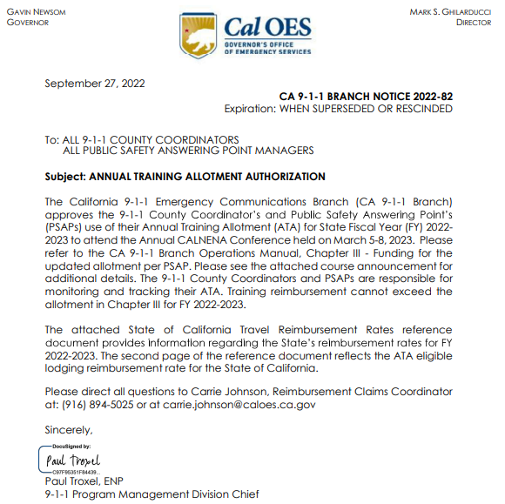
What Trainings Are Reimbursable?
The CA 9-1-1 Branch will issue advance notification of pre-approved specifically defined 9-1-1 related training.
If notification of a specific 9-1-1 related training is not published and posted on the CA 9-1-1 Branch website, then pre-approval by the CA 9-1-1 Branch will be required.

Slide 6
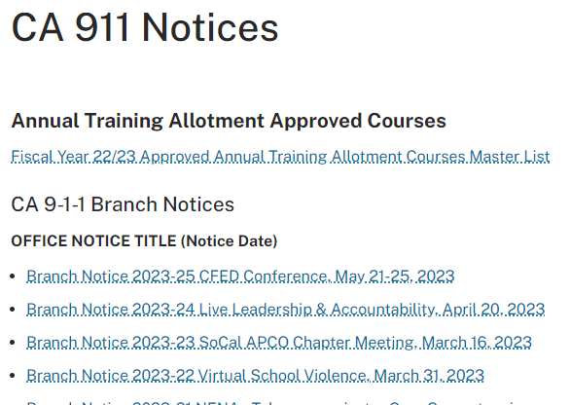
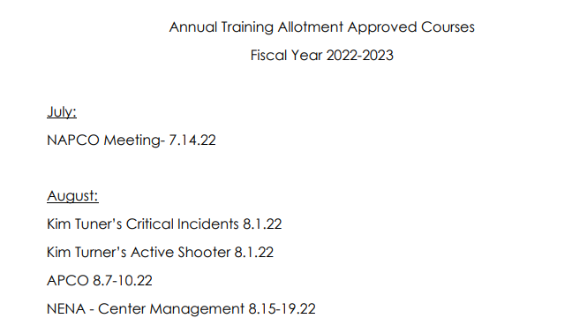
What Trainings Are Reimbursable?
All approved ATA branch notices can be found on the Caloes.ca.gov website at: CA 911 Notices | California Governor's Office of Emergency Services

Slide 7
Types of Reimbursement Expenses
Event registration for all APPROVED Pre-Conference Courses and Annual Training
Hotel
Parking (self-parking, not valet)
Transportation (airfare; car rental/gasoline; train, Uber; shuttle; taxi)
Agency vehicles may not submit mileage, but may submit gas receipts
Mileage can be reimbursed for personal vehicle use (map and written directions must be included)
Meals (that are not included in the event according to the State published rate)
Wages of event participation, not to exceed 8 hours per day, no overtime
Agency may pay overtime, however, this is not reimbursable using ATA funds.

Slide 8
No Third-Party Vendors
The State Controller's Office (SCO) has established strict requirements for reimbursement of employee travel paid to third party vendors.
Third party vendors include, but are not limited to, Internet companies such as Air B&B Priceline.com, Expedia.com, Travelocity.com, Hotels.com, etc. The California Department of Human Resources (CalHR) has strongly advised that State travelers use a Department of General Services (DGS) approved travel agency to make travel arrangements (Concur).

Slide 9
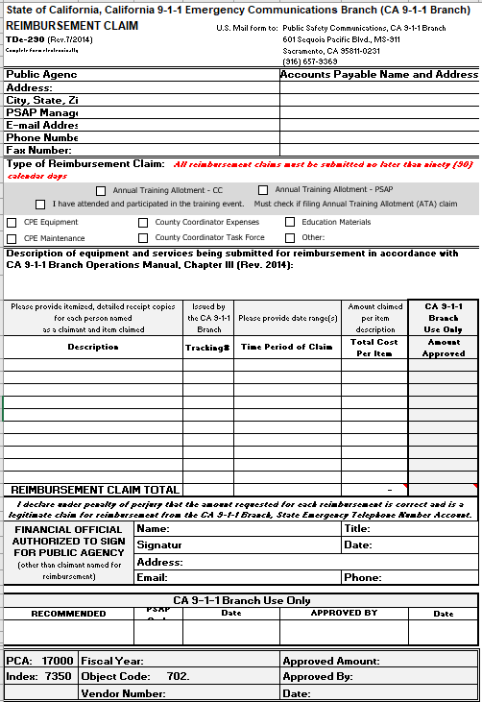
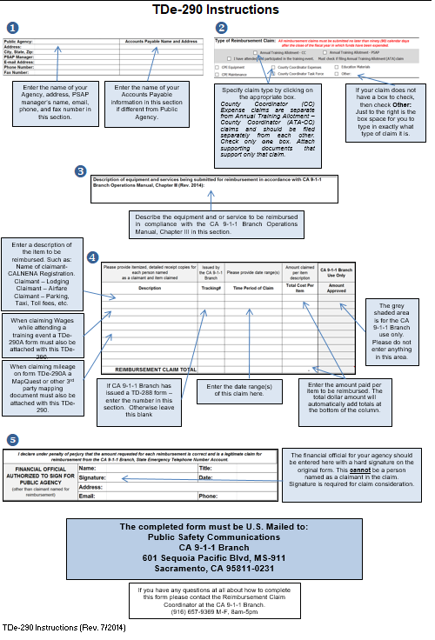
TDe-290 Reimbursement Form

Slide 10
TDe-290 Reimbursement Form

Slide 11
TDe-290 Reimbursement Form
County Coordinator (CC)
Public Safety Answering Point (PSAP)

Slide 12
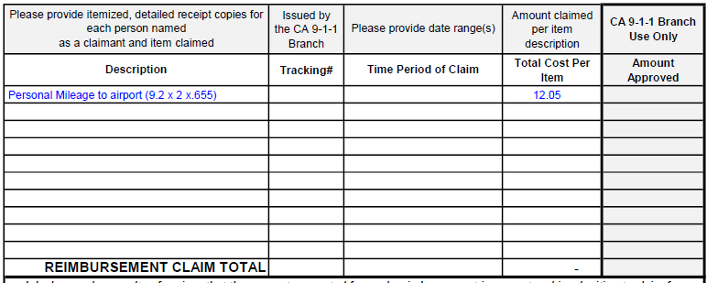
Personal Mileage
As of January 1, 2023: Personal milage .655/mile

Slide 13
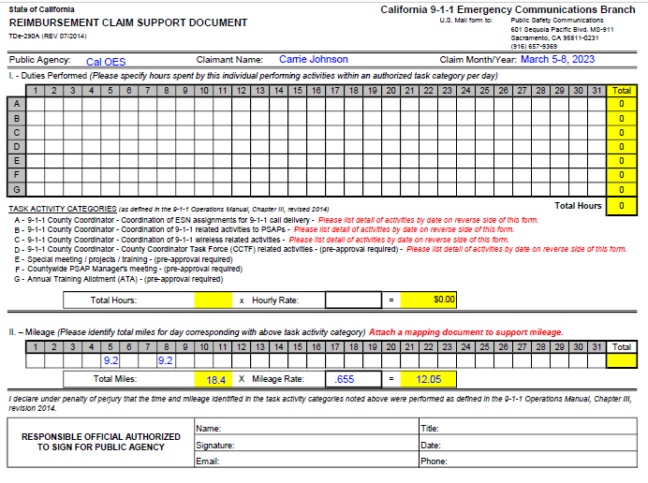
TDe-290A Personal Milage

Slide 14
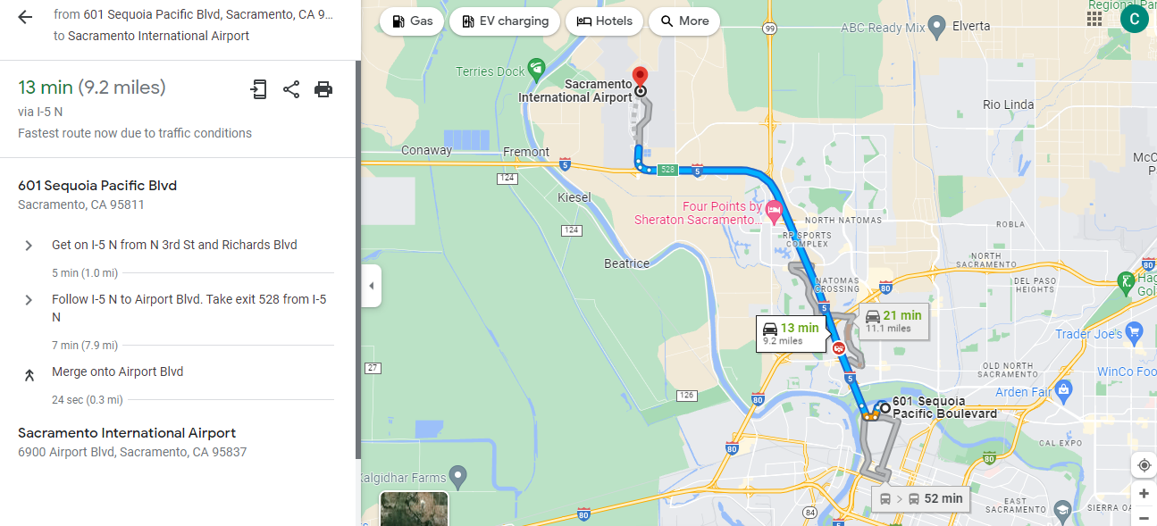
Personal Mileage
Must have Google Maps + Text

Slide 15
Mileage Reimbursement
MILEAGE:
July 1, 2022 – December 31, 2022: $0.625
January 1, 2023- present: $0.655
Car Rental Rates
The Mileage Reimbursement Calculator assists you in determining whether renting a vehicle or using a personal car is the most cost-effective method of transportation!
The Travel department performs a cost comparison for mileage vs cost of rental car from Enterprise and reimburses the lesser.
Further information can be found at: Travel Reimbursements - CalHR

Slide 16
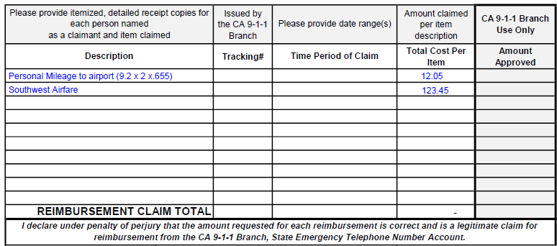
Airfare

Slide 17
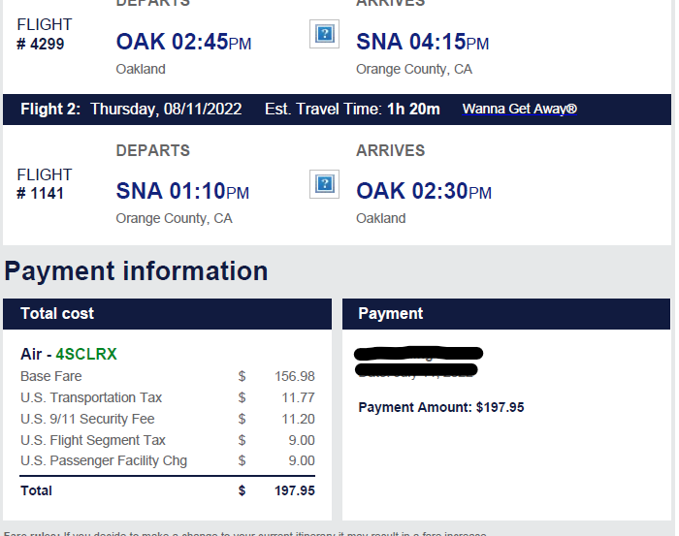
Airfare Receipt

Slide 18
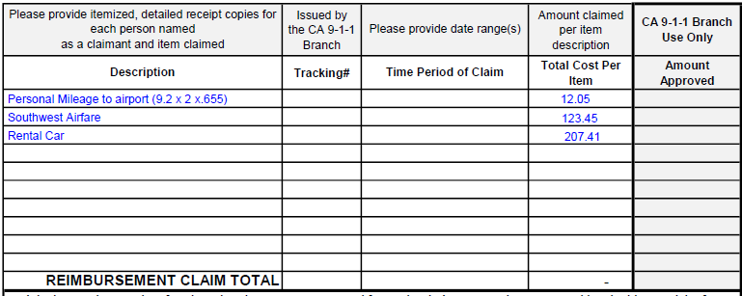
Rental Car

Slide 19
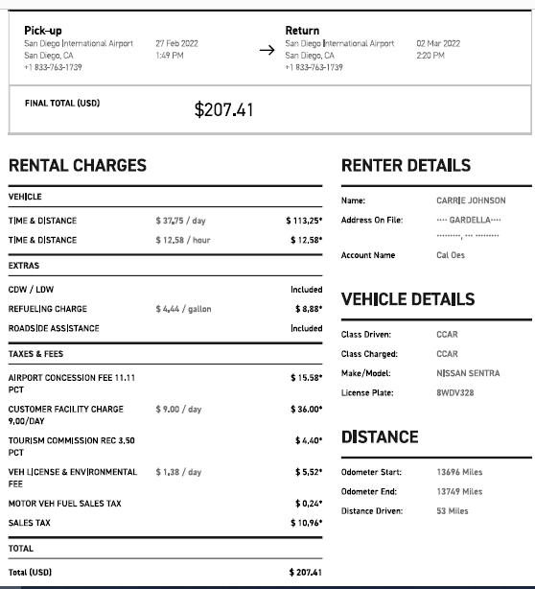
Rental Car Receipt

Slide 20
Allowable Reimbursable Expenses
TRANSPORTATION :
Reimbursement expenses will be based on the method of transportation that is in the best interest of the state, considering both direct expense and the employee's time
Allowable forms of transportation include:
Airline fare
Airport Parking
Car Rental
Taxi/Uber/Lyft – Tips are not reimbursable
Tolls
Train
Please note: Receipts and itineraries are required to be included in requests for reimbursement.

Slide 21
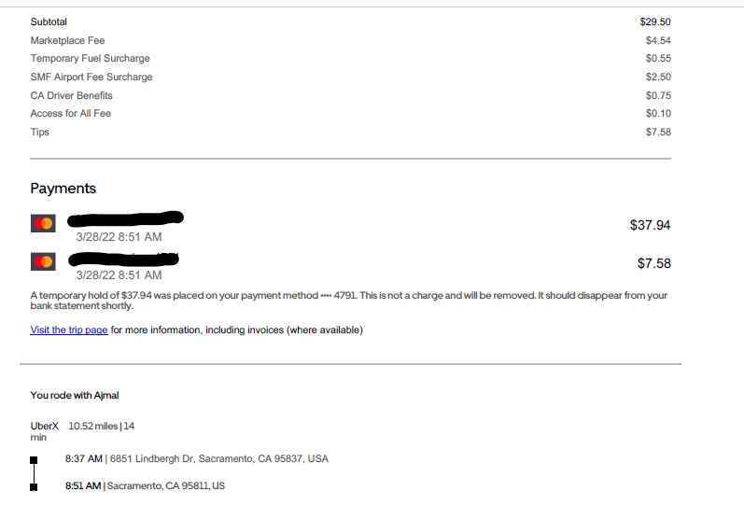
Uber/ Lyft
Only to from airport to hotel &
hotel to conference

Slide 22
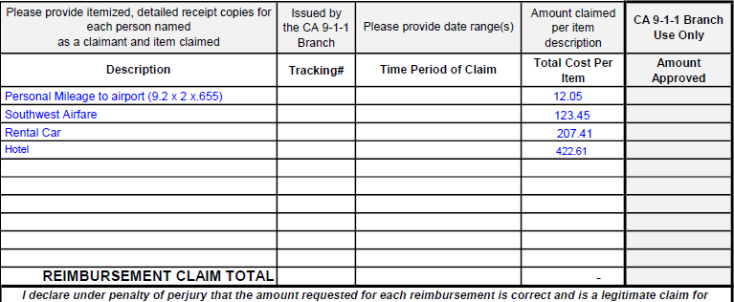
Hotel

Slide 23
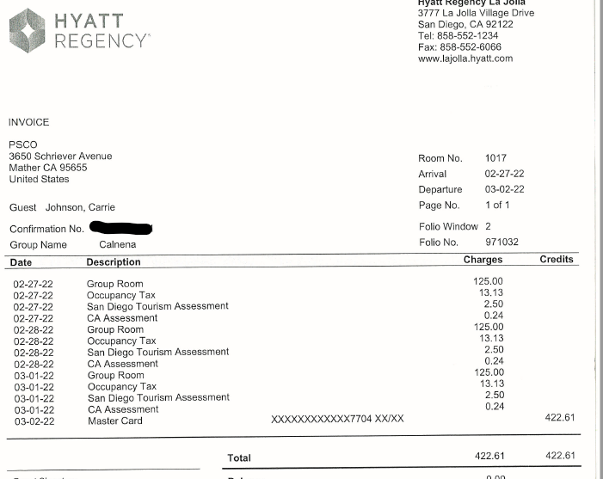
Lodging Reimbursement

Slide 24
Lodging Reimbursement
State does not reimburse for third party vendor confirmations/receipts (Priceline.com, Hotels.com, etc.)
Itemized receipts are required for all lodging expenses and must be generated by the commercial establishment.
The receipt needs to include:
The name and address of the hotel
The employee’s check- in date, check-out date
An itemization of expenses incurred, and payment made.

Slide 25
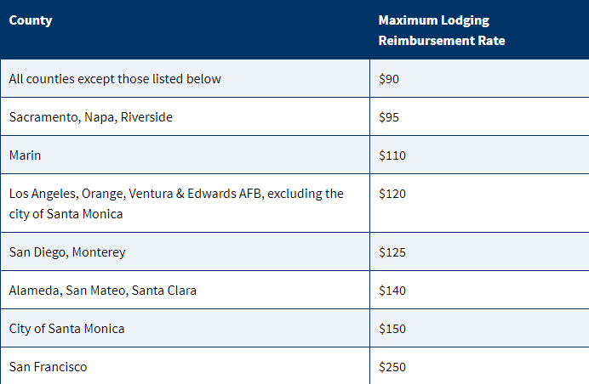
Lodging Reimbursement Rates

Slide 26
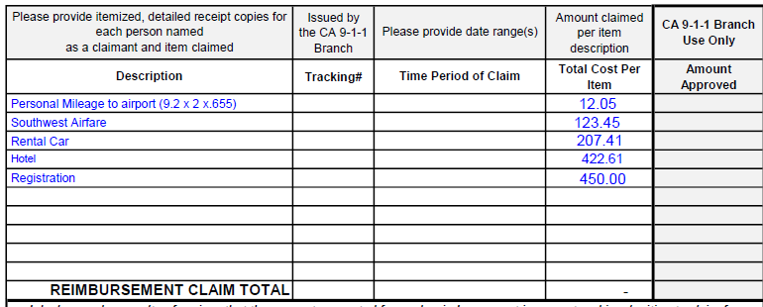
Registration

Slide 27
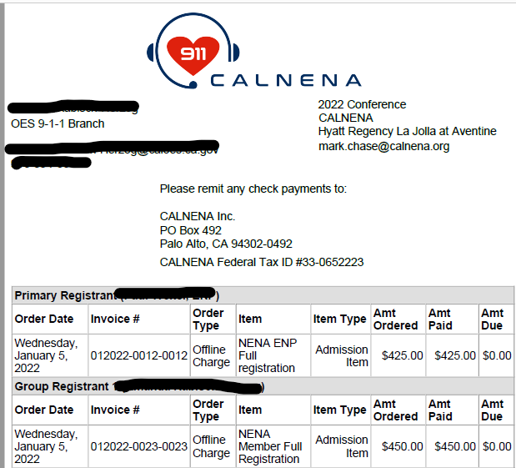
Paid Registration

Slide 28
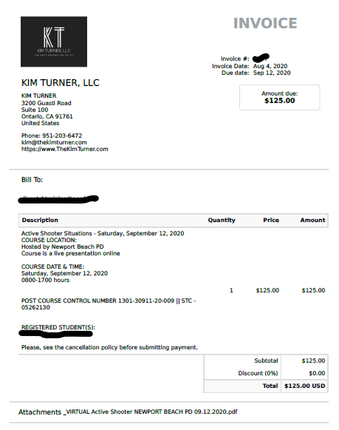
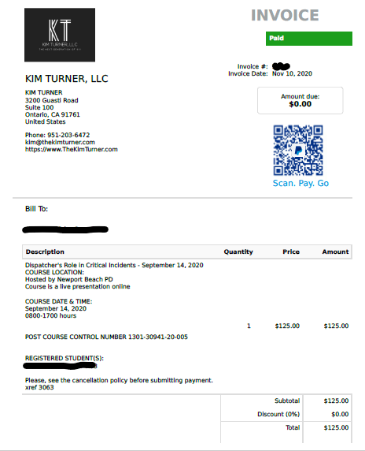
Invoices
Not Paid Invoice Paid Invoice

Slide 29
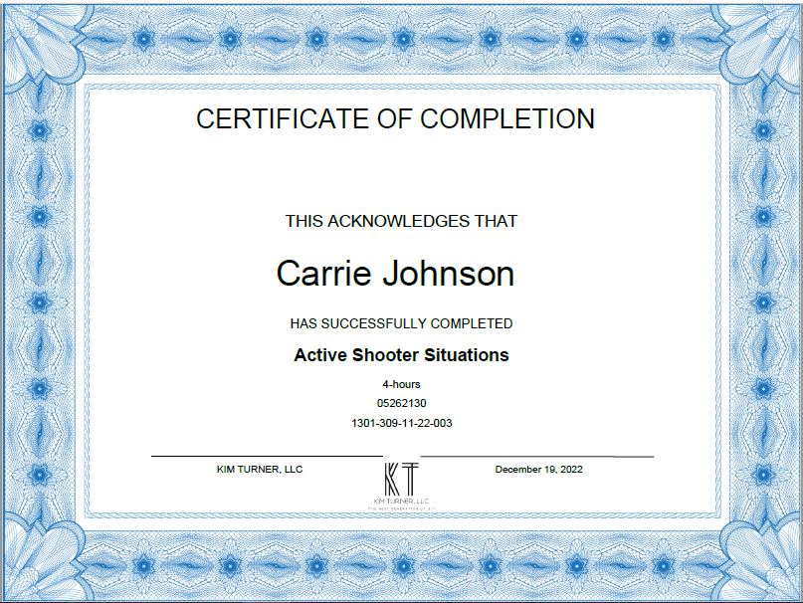
Certificate of Completion

Slide 30
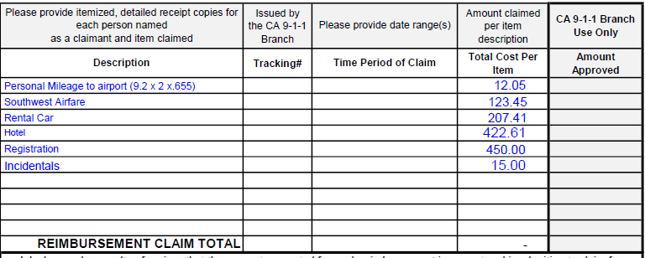
Incidentals
Incidentals: $5/day after first 24 hours

Slide 31
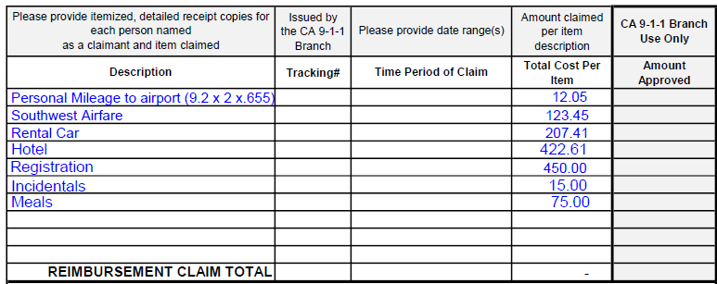
Meals

Slide 32
Calculating Meals
State does not reimburse meals when they are provided
Meals Claimed:
Sunday (Lunch & Dinner): $34
Monday (Dinner): $23
Tuesday : $0
Wednesday (Breakfast & Lunch): $18
Total: $75.00
Meals Provided at Cal NENA:
Monday March 6th: Breakfast & Lunch
Tuesday March 7th: Breakfast, Lunch & Dinner

Slide 33
Meals & Incidentals Expense

Slide 34
Meals For Travels Lasting 24hrs
For travel lasting 24 hours or more, employees may claim meals based on the following timeframes:
First day of travel:
Trip begins at or before 6 am - Breakfast may be claimed
Trip begins at or before 11 am - Lunch may be claimed
Trip begins at or before 5 pm - Dinner may be claimed
Continuing travel after 24 hours:
Trip ends at or after 8 am - Breakfast may be claimed
Trip ends at or after 2 pm - Lunch may be claimed
Trip ends at or after 7 pm - Dinner may be claimed

Slide 35
Meals During Fractional Day Travel
Fractional day travel (trips less than 24 hours):
Trip begins at or before 6 am and ends at or after 9 am - Breakfast may be claimed
Trip begins at or before 4 pm and ends at or after 7 pm - Dinner may be claimed
Employees may not claim lunch or incidentals on one-day trips. When trips are less than 24 hours and there's no overnight stay, meals claimed are taxable.
Employees may not claim meals provided by the state, meals included in hotel expenses or conference fees, meals included in transportation costs such as airline tickets, or meals that are otherwise provided. Snacks and continental breakfasts such as rolls, juice, and coffee are not considered to be meals. Tips are not reimbursable.

Slide 36
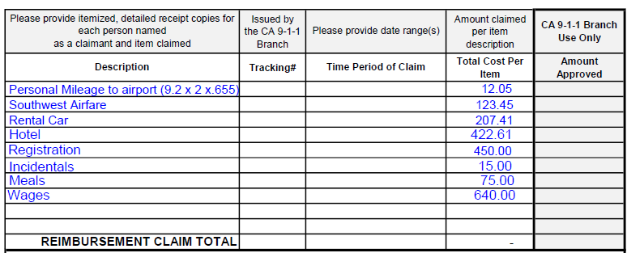
Wages

Slide 37
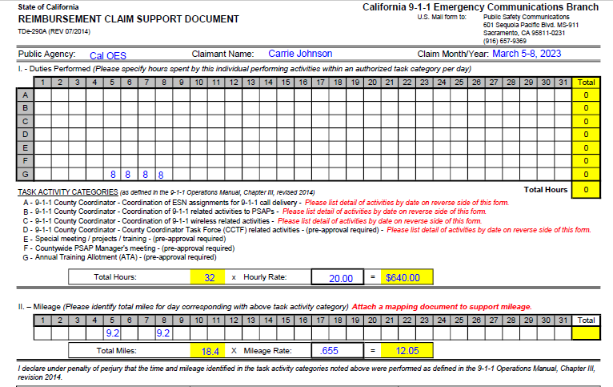
TDe-290A Wages
Hourly Rate + Benefits

Slide 38
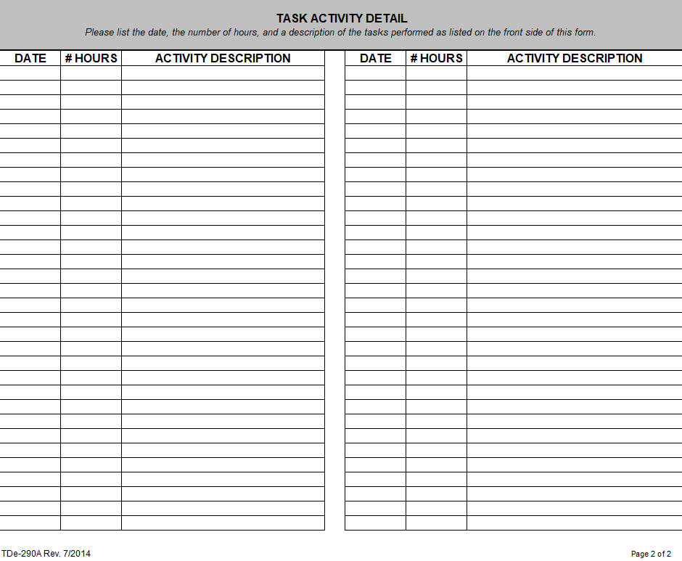
TDe-290A Continued
3/5 8 Cal NENA Conference
3/6 8 Cal NENA Conference
Wages of event participation, not to exceed 8 hours per day, no overtime
Agency may pay overtime, however, this is not reimbursable using ATA funds.
3/7 8 Cal NENA Conference
3/8 8 Cal NENA Conference

Slide 39
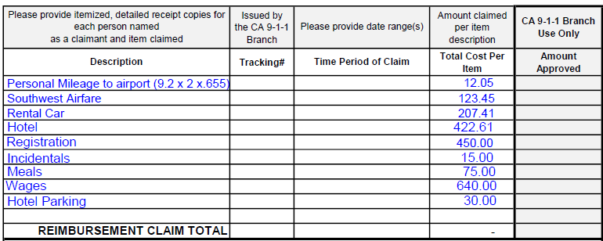
Parking

Slide 40
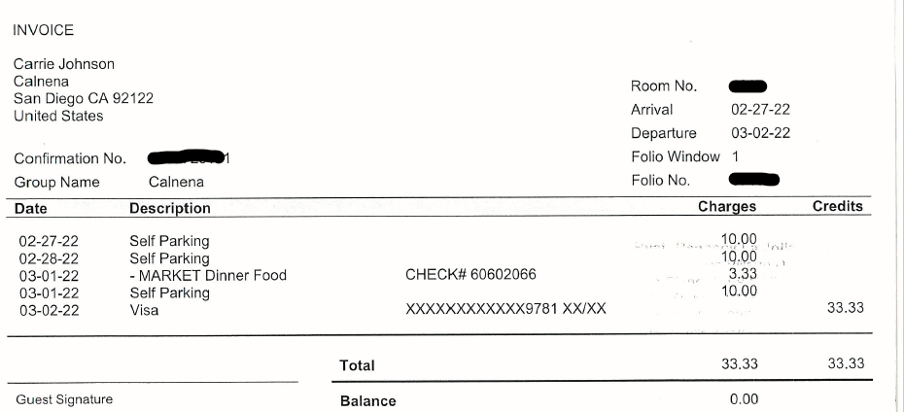
Hotel Parking

Slide 41
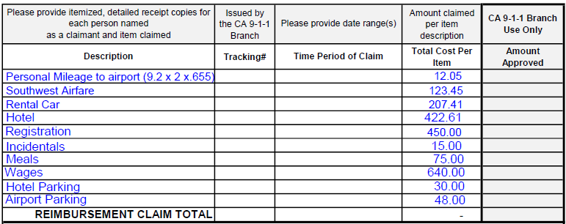
Parking

Slide 42
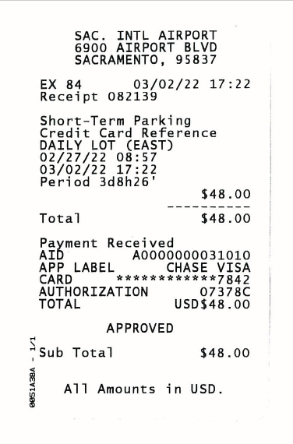
Airport Parking Receipt
Self Parking only
No valet parking

Slide 43
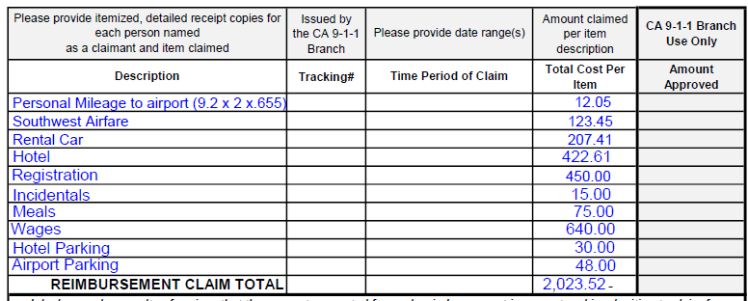
Total

Slide 44
Signature
Don’t forget to sign!!

Slide 45
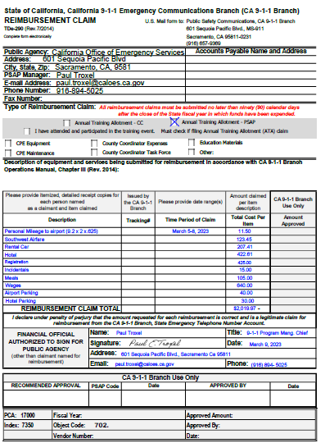
Completed Form

Slide 46
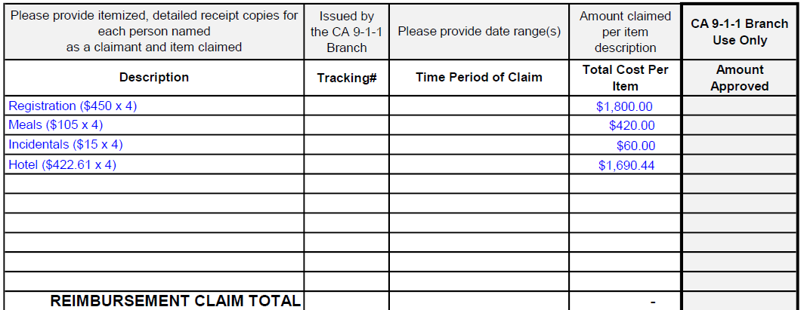
Multiple People

Slide 47
County Coordinator
Annual Training Allotment
County Coordinator wages and MSAG Duties
Operations Manual- Chapter VIII - 9-1-1 County Coordinator and MSAG Responsibilities (ca.gov)
Wages + benefits

Slide 48
Reimbursement Policy
Timely Submission of Claims
All reimbursement claims must be submitted on an annual, semi-annual, or quarterly basis each fiscal year (July 1 through June 30) and must be submitted no later than ninety (90) calendar days (September 30) after the close of the fiscal year in which funds have been expended

Slide 49
ATA Approval Guidelines/Policies
Authorization to utilize ATA funds must support PSAP Operations statewide
POST Training Courses must support PSAP Operations AND be submitted as POST Plan N/A – No POST reimbursement
Reimbursement to agency may or may not go directly back to agency. That is controlled by agency, not the CA 9-1-1 Branch.
If you are hosting a training and would like to have it approved of ATA, please reach out to carrie.johnson@caloes.ca.gov and janee.dabrowski@caloes.ca.gov

Slide 50
Reimbursement Links for Travel
State Travel Rates:
https://www.calhr.ca.gov/employees/Pages/travel-reimbursements.aspx
https://www.documents.dgs.ca.gov/dgs/fmc/pdf/std204.pdf
https://www.documents.dgs.ca.gov/dgs/fmc/pdf/std262.pdf
Chapter 3: Funding
Chapter III- Funding (ca.gov)
Chapter 8: County Coordinator & MSAG Responsibilities
Operations Manual- Chapter VIII - 9-1-1 County Coordinator and MSAG Responsibilities (ca.gov)
TDe-290
OES-PSC-290-Reimbursement-Claim-complete.xlsx (live.com)
TDe-290A
OES-PSC-290-Reimbursement-Claim-complete.xlsx (live.com)

Slide 51
Questions?
Carrie.Johnson@caloes.ca.gov

